Slide 1
Estimation of Actuation Configuration for a Multi-Actuated Blimp
Final Presentation (Semester Thesis)
Students: Matthias Krebs Advisors: Kostas Alexis
Simon Laube Markus Achtelik

Slide 2
Content
System Overview
Problem Formulation
Parameters
System Model
Input Pattern
Optimization
Results
Simulation Results
Experimental Results
Ground Truth
Conclusion & Outlook

Slide 3
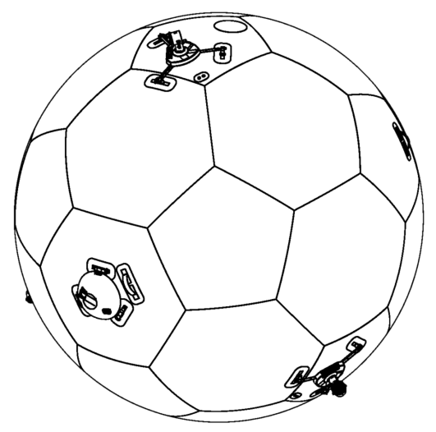
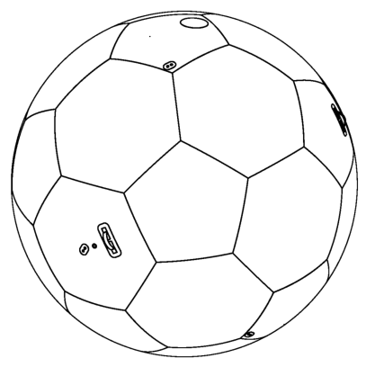
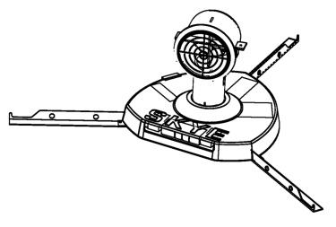
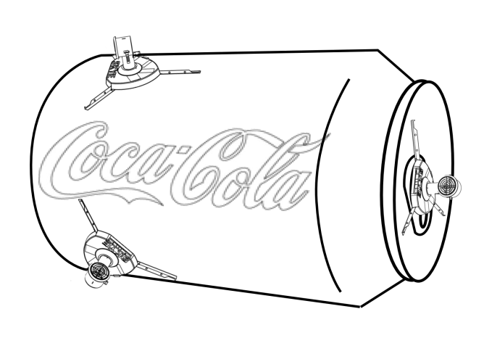
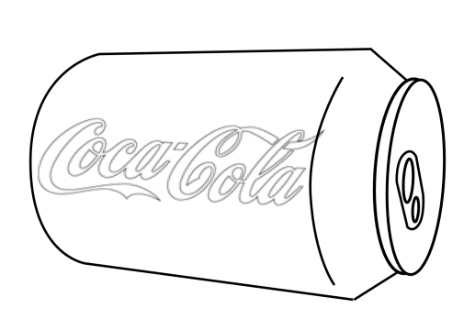
Motivation: Control Arbitrary Blimp
Parameter Identification
Arbitrary Blimp Hulls
Skye Actuation Unit
Elegant Movement
Notes:
Vision to Provide Actuation Units
Placed on arbitrary blimp
Controller works without manual adjustment
So think about flying comercials as this coke can blimp where we just place our AU‘s which make them fly!

Slide 4
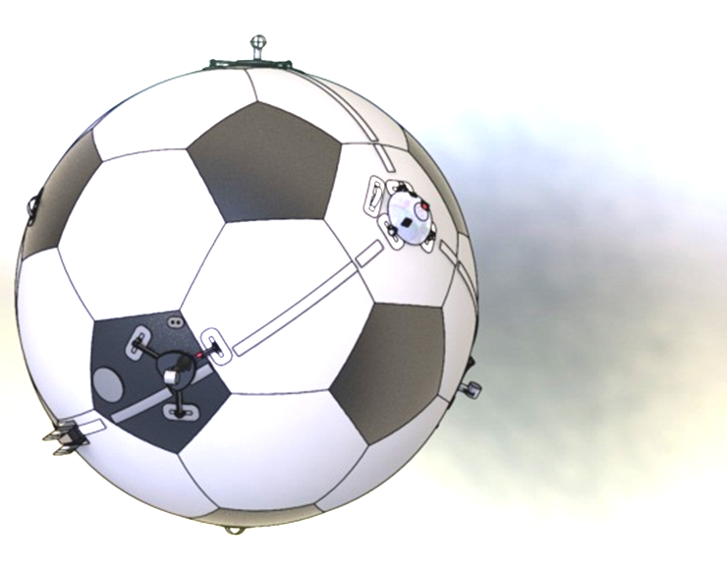
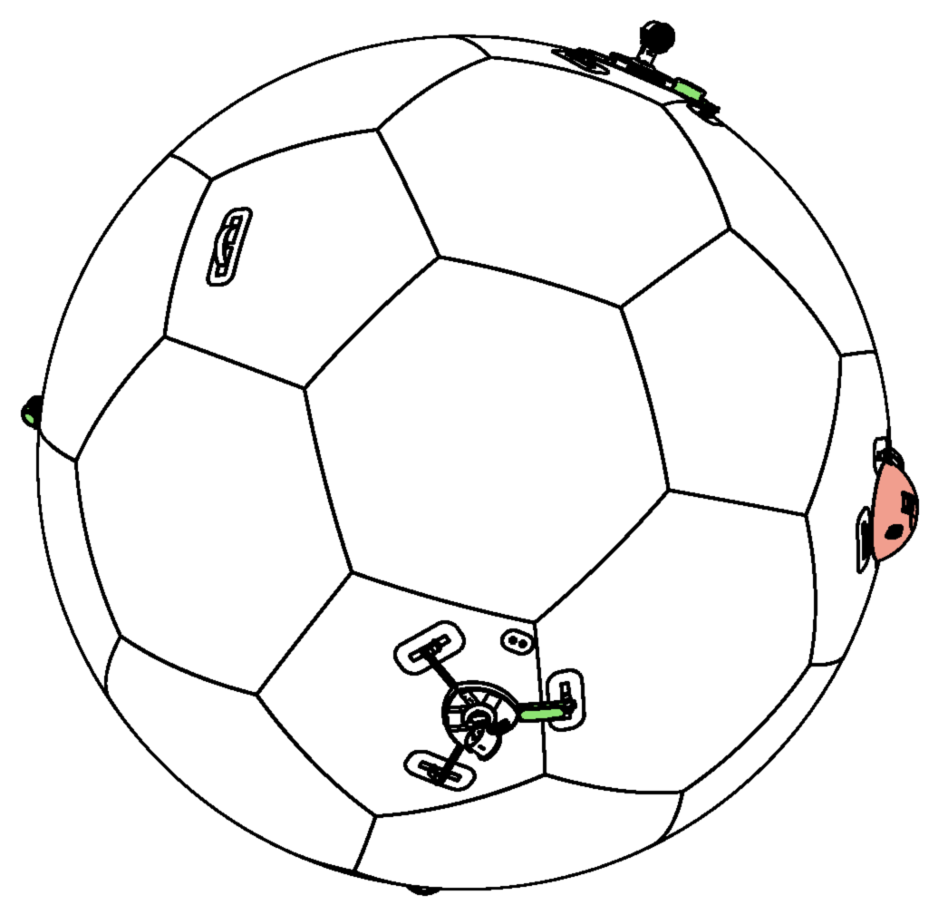
Motivation: Improve Usability & Control
taring weights
Controller
Hard to measure
Change payload
J cog
C_{bm}
Arbitrary Blimp Hulls
Help with system taring
Determine hard to measure parameters
Notes:
Other benefits: Blimp needs to be tared after each setup.
Algorithms helps to simplify this procedere which takes always up to half an hour
Or it can also detect if you remove/add any parts.
Finally, also controller tuning will be simplified, if we can provide some hard to measure parameters as the inertia tensor

Slide 5
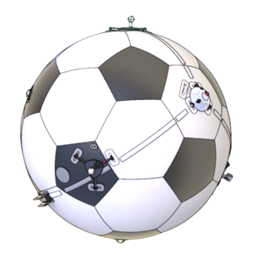
Problem Formulation
IMU Data
Actuator Input Pattern .
Parameter
Optimization Algorithm
System Model
Model Output
Notes:
With those goals in mind we can formulate the optimization problem:
One one hand, we apply some specific inputs to the real system and measure input/output behaviour.
Then, we apply the same inputs to a parametric system model.
By comparing the model output to the measured system output, we update the parameters
until system model best fits the true system.

Slide 6
Problem Formulation
IMU Data
Actuator Input Pattern .
Parameter
Optimization Algorithm
System Model
Model Output
Notes:
In the following, I will explain you all steps in detail, before Simon will show our results.
Let‘s start with the true system „Skye“

Slide 7
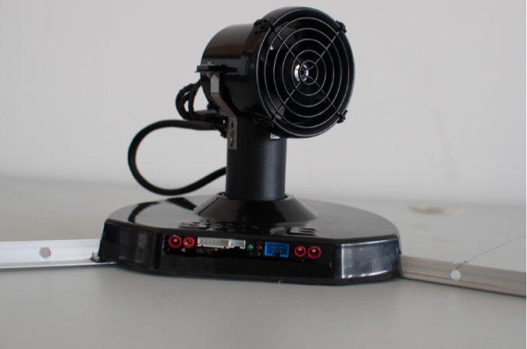
Problem Formulation: System
Spherical Hull filled with Helium
4 Actuation Units (AU)
Electronics:
IMU
Controller
XBee
Rotation
Thrust
Notes:
Skye is a spherical blimp with 4 AU‘s placed on the helium filled hull by velcro.
It is controlled by a pixhawk IMU and communicates with the pilot by a xBee module.
The special thing about the Aus is that they can rotate around its axis. So they can generate thrust in any direction tangentially to the hull.

Slide 8
Problem Formulation: System Control
Independent of Actuators
Depends on Actuators
Notes:
Some words about the controller: The controller is independent of the actuation configuration and determines a desired rotational and translational acceleration.
The allocation part translates those 6 signals to the single actuation inputs and therefore requires to know the actuation configuration.

Slide 9
Problem Formulation
IMU Data
Actuator Input Pattern .
Parameter
Optimization Algorithm
System Model
Model Output
Notes:
On the opposite side, we have the system model.

Slide 10
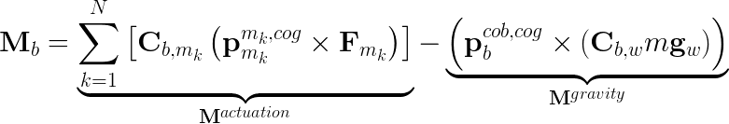
Problem Formulation: System Model
Angular Acceleration
with
Aerodynamic effects on rotation neglected (M^{aero} << M^{actuation})
Notes:
From the IMU, we have the gyro and accelerometer measrements. Since there are some complications with the graviational offset of the accelerometer on a omnidirectional system, we focused on only the gyro outputs, which provides us with the necessary data.
Our model for the angular acceleration is shown here. It includes the active moment and the nutatino term diveded by the inertia tensor.
This part of the moment is the actuation, the other considers the offset between center of gravity and center of buoyancy.
Aerodynamic is neglected …
Halbwertszeit der Rotation ist ca. 50 sec

Slide 11
Problem Formulation
IMU Data
Actuator Input Pattern .
Parameter
Optimization Algorithm
System Model
Model Output

Slide 12
Problem Formulation: Parameters
Actuator
Actuator Arrangement
Actuator Arrangement
Actuator Arrangement
Orientation SO(3)
Center of Gravity R³
Mass R
Drag Torque coeff. R
Inertia Tensor Sym(3)
Radius
R
Full Parameter set is only jointly observable
Notes:
The system model consists the following parameters:
Each AU on the spherical hull is positioned by its rotation
-Drag torque coefficient was not shown in the equation before, but could also be added for a moment parallel to the actuation force.
COG is three dimesional vector
Mass is scalar
Inertia tensor is symetric matrix with 6 parameters
Radis is again scalar
Those paramaters are not fully observable.

Slide 13
Problem Formulation: Parameters
Actuator Arrangement
Actuator Arrangement
Actuator Arrangement
Actuator Arrangement
Orientation SO(3)
Center of Gravity R³
Mass R
Drag Torque coeff. R
Inertia Tensor Sym(3)
Radius
R
Assume jointly observable parameters as known
For 4AUs: 21 Parameters
Notes:
We figured out that mass and radius scale the cog and the inertia tensor respectively.
The drag torque just rotates the geometrical orientation of the AU radial to the blimp.
Therefore if we fix those parameters, we can observe the others.
21 Parameters

Slide 14
Problem Formulation: Parameters
Parameter
Angular Acceleration
with
Constant (known)
State (known)
Notes:
C: Rotation matrix
Motor position on a sphere: radius!

Slide 15
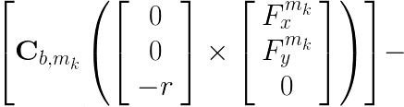
Problem Formulation: Parameters
Parameter
Angular Acceleration
with
Constant (known)
State (known)

Slide 16
Problem Formulation
IMU Data
Actuator Input Pattern .
Parameter
Optimization Algorithm
System Model
Model Output

Slide 17
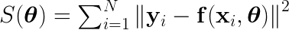
Problem Formulation: Optimization
Nonlinear Least Squares
Levenberg-Marquardt
Gradient based minimization
Robust and fast convergence

Slide 18
Problem Formulation
IMU Data
Actuator Input Pattern .
Parameter
Optimization Algorithm
System Model
Model Output

Slide 19
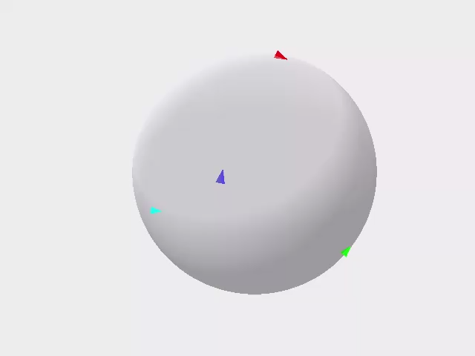
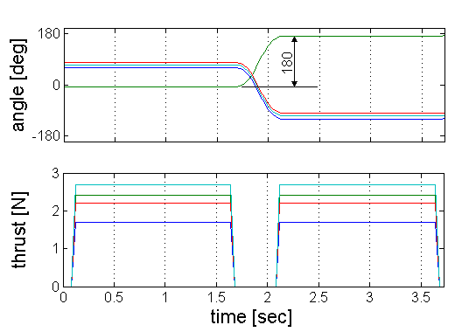
Problem Formulation: Input Pattern
Inputs must be applicable and sufficiently excited
Forward/backward
Varying directions
Steady state motor dynamics

Slide 20
Simulator
Object oriented simulator in Matlab
Modular concept for (almost) arbitrary blimps
Assembly
parts, Hamiltonians, …
Simplified view
Skye
Part
mass, inertia, dimension, c_{w}, …
Hull
AU
Eye
AU
AU
AU
IMU
…
Actuator
States, active forces …
Taring
Act
…
Simulator
Dataset
Notes:
-since we are estimating...
-this is why we built a modular simulator which can simulate blimps with aerodynamic effects
-a blimp is modelled according the displayed tree
#explain objects
-the simulator then interacts ...

Slide 21
Results
Simulation Results
Experimental Results
Groundtruth with Leica

Slide 22
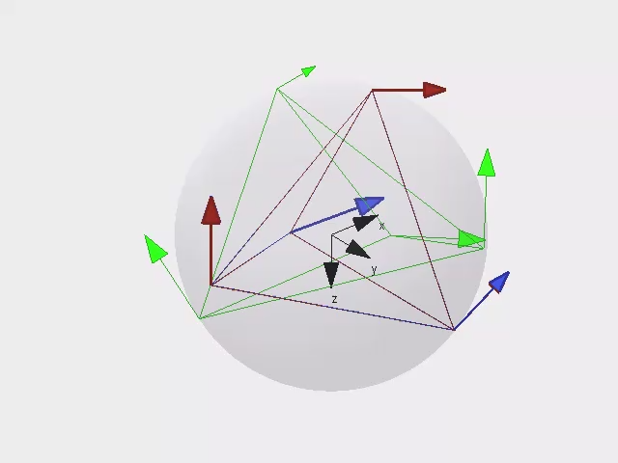
Results
x
α
y
6 LMA Iterations
Init
True
Batch
Notes:
-here we can see an example of a good optimisation result ... 6 iterations ...
-to compare results we need to define a intuitive measure
#explain

Slide 23
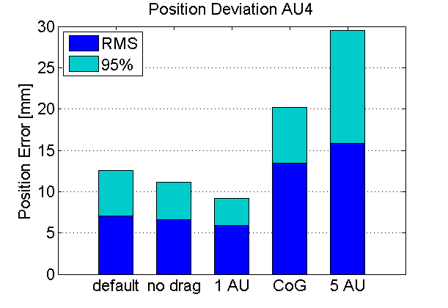
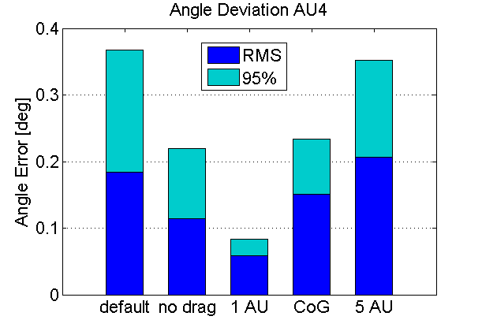
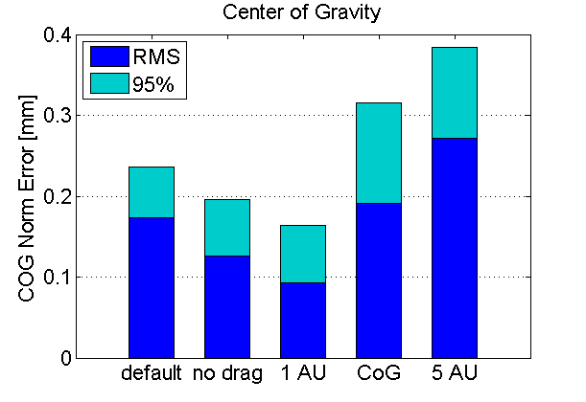
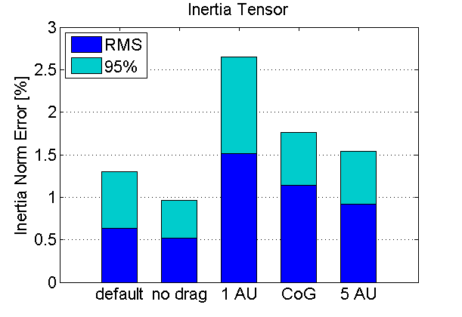
Simulation: Casestudies
16 simulations à 40 seconds
Notes:
-to test the performance ... several case studies
-for each of these cases
-first we looked into the effect of different amount of ... explain.
-then we analyzed the effect of our simplifications
-to compare the effect of drag .. the error comes from IMU
-in the cog dataset we put a huge cog offset .. same order of magnitude as motors .. controlled flight not possible
-error is acceptable
#explain angle
-one intersting thing is cog estimation really accurate
-another intersting thing is the tensor with au4

Slide 24
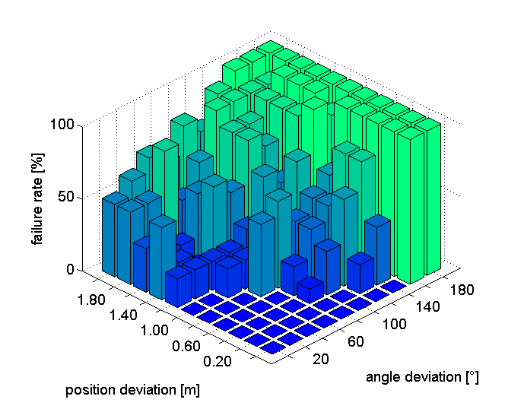
Simulation: Convergence Region
x
α
y
Initial Parameters can be about 1m or 120° apart of the true value
Notes:
another important topic ... convergence region
#recall from picture
-what we can see here
-thus we only need a rough estimate of the blimp

Slide 25
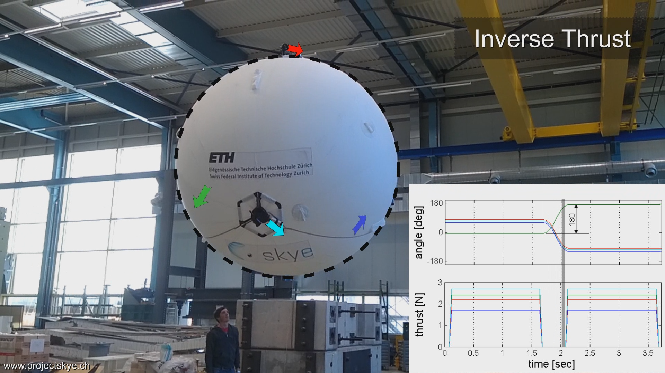

Data Acquisition
Notes:
-as we said earlier we applied inputs to the system ...
-we can see the movement ...

Slide 26
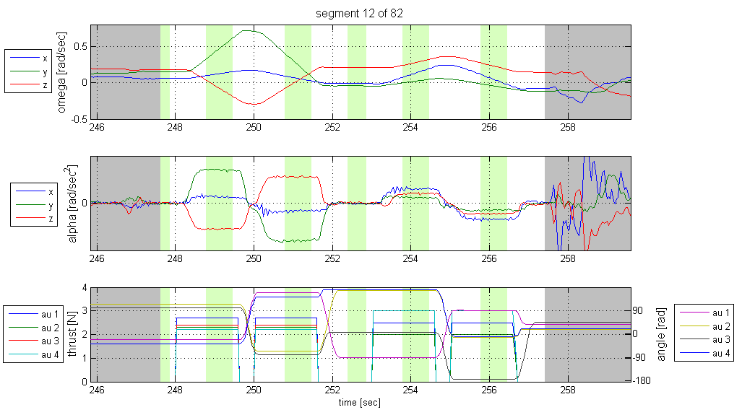
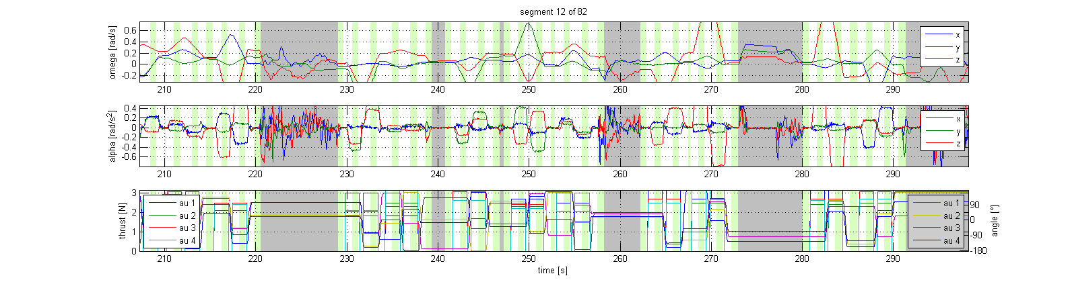
Data Acquisition
Disturbance:
Skye has been catched
Notes:
-after that recording session ..
#explain first plot
#tell about atomatic intersting segment extraction with manual checking

Slide 27
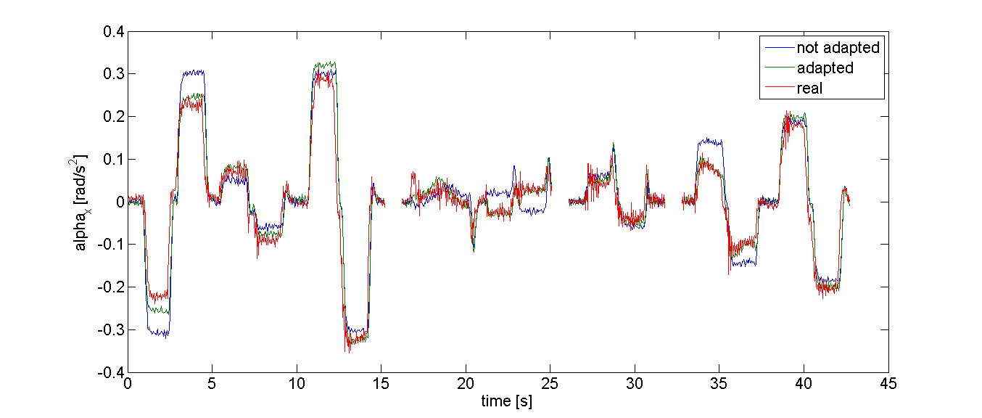
Results: Real Data vs. Simulation Data
Notes:
- to see wether the batch optimisation works ... compared simulation with real .. once for default skye we have from manufacturing data ... then for the skye from batch
- clearly batch optimized is better

Slide 28
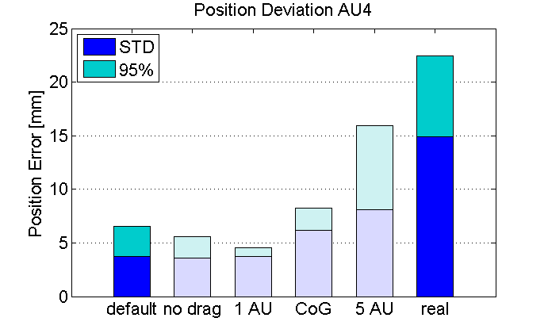
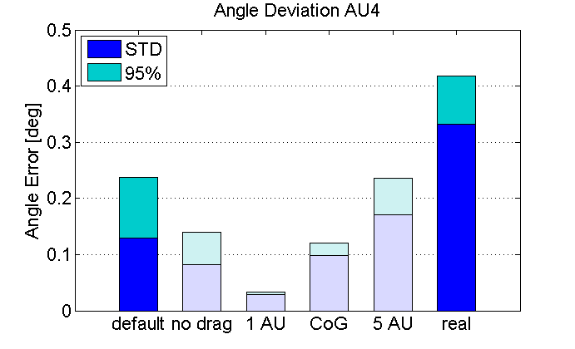
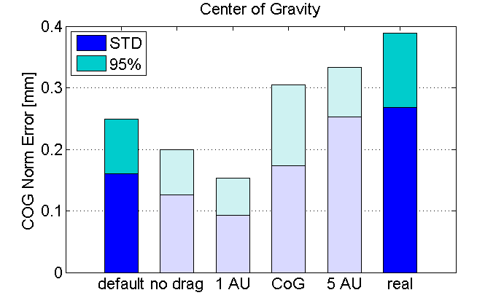
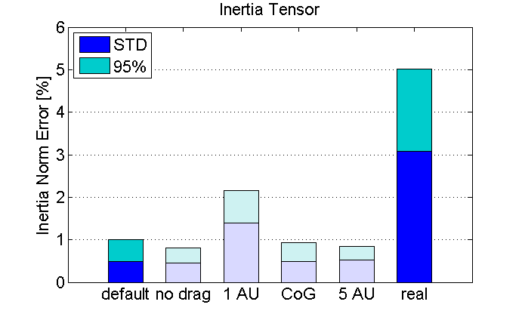
Results: Real Data vs. Simulation Data
16 datasets à 40 seconds
Notes:
-now that we know that the batch is correct ..
-std dev is higher but still good (2cm)

Slide 29
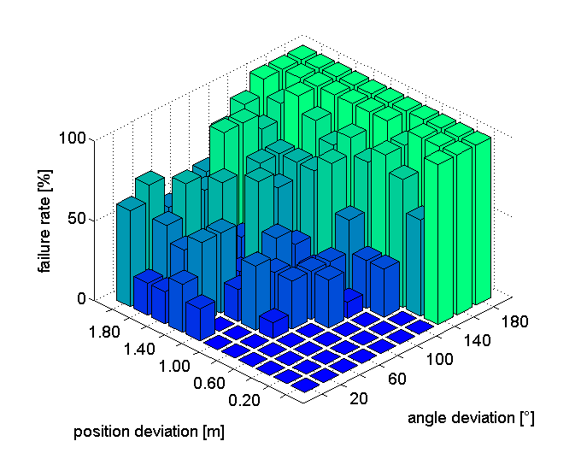
Experiment: Convergence Region
Very similar to simulation data.
Notes:
-the convergence region looks very similar to the simulation

Slide 30
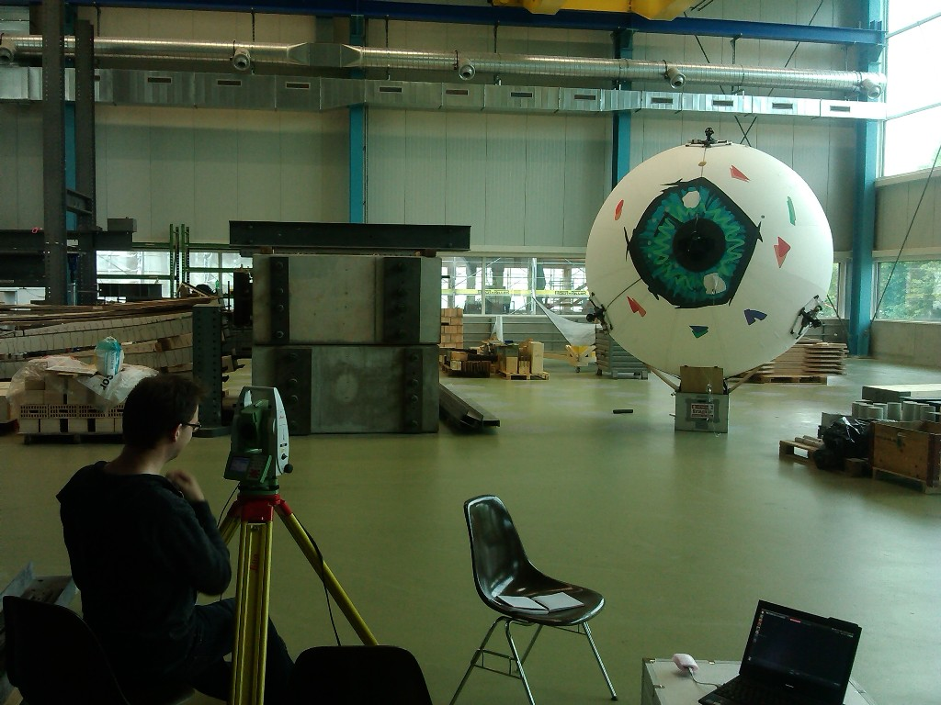
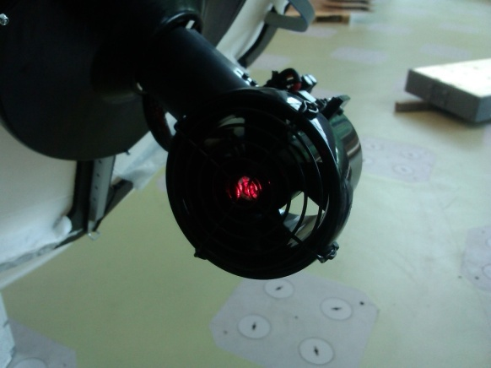
Results: „Ground Truth“ (Leica)
3 AU‘s visible at once
Use different views
Fit data to get tetrahedral‘s edge length
Residual below 0.01m
Notes:
-to get a ground truth value .. we had to measure from different .. views
-each view gives edge lengths of the tetraheder
-combine with optimisation

Slide 31
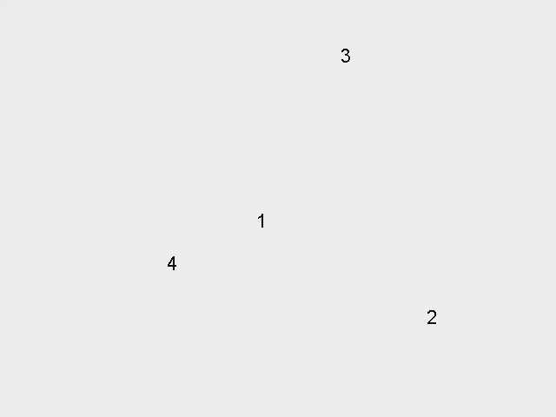
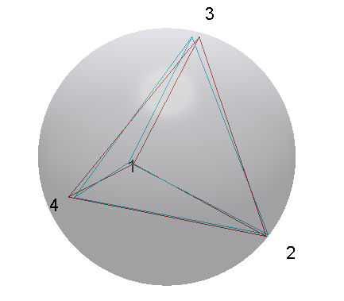
Results: Compare Leica and Batch Solution
Relative tetrahedral edge length error
% | AU2 | AU3 | AU4
AU1 | 1.68 | 0.86 | 2.76
AU2 |  | 0.67 | 2.47
AU3 |  |  | 3.78
Leica
Batch
Notes:
-and finally if we compare ... error of maximum 3%

Slide 32
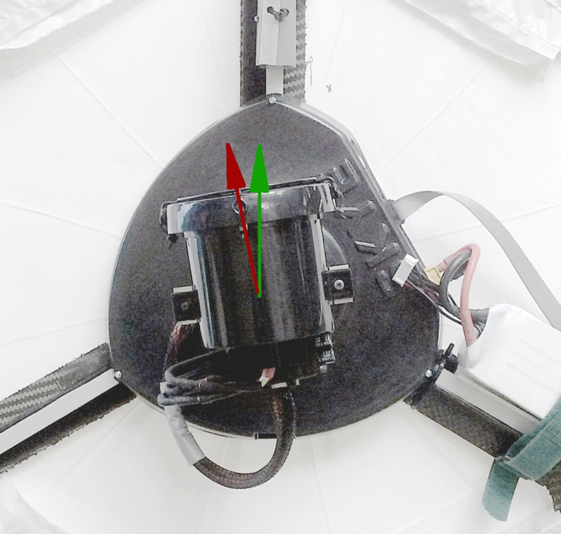
…
assumed
batch sol.
Notes:
-one more thing: when analyzing the data from ... discovered that the actuator must be misaligned .. and indeed it is

Slide 33
Conclusion
What did we do?
Showed applicable method to estimate actuator configuration
How accurate?
Actuator positions can be estimated within centimeters
Where to use?
Automatically update parameters before flight within minutes
Notes:
to quickly conclude:
-we showed e method wich can estimate the actuator configuration within centimeters
-one application could be to quickly recalibrate the system before flight

Slide 34
Thanks

Slide 35
FORMULAS
\mathbf{f}(\mathbf{x},\mathbf{u},\boldsymbol{\theta}) = \hat{\boldsymbol{\alpha}_b} = \mathbf{J}_b^{-1} (\mathbf{M}_b - \boldsymbol{\omega}_b \times \mathbf{J}_b \boldsymbol{\omega}_b )
\mathbf{M}_b = \underbrace{\sum_{k=1}^N { \left[ \mathbf{C}_{b,m_k} \left( \mathbf{p}^{m_k,cog}_{m_k} \times \mathbf{F}_{m_k} \right)} \right]}_{\mathbf{M}^{actuation}}
-
\underbrace{
\left( \mathbf{p}^{cob,cog}_b \times (\mathbf{C}_{b,w}m\mathbf{g}_w) \right)
}_{\mathbf{M}^{gravity}}
S(\boldsymbol{\theta})=\sum_{i=1}^{N}{ \left\| \mathbf{y}_i-\mathbf{f}(\mathbf{x}_i,\boldsymbol{\theta}) \right\| ^2}
(\mathbf{J}^\top\mathbf{J}+\lambda \text{diag}(\mathbf{J}^\top\mathbf{J}))\boldsymbol{\delta}=\mathbf{J}^\top[\mathbf{y}-\mathbf{f}(\boldsymbol{\theta})]

